Slide 1

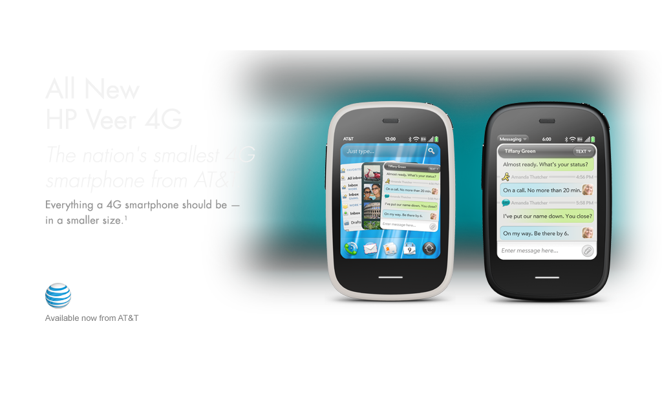
MSC – Media Supply Chain Program August 3, 2011

Slide 2

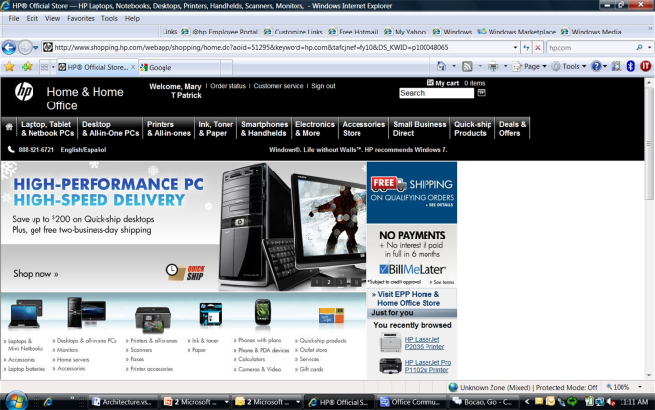
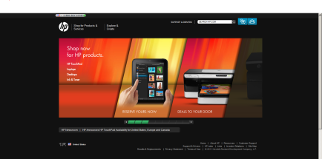

Media Supply Chain Drivers
HP must deliver engaging and consistent content to customers regardless of the channel through which they experience it or the location of the world in which they live.
Find and use (& re-use, translate, localize, repurpose) HP rich media assets
Drive media spend efficiencies
Create the ability to efficiently and effectively store, manage and deliver rich media
Syndicate and stream our content to channel partners, social media sites and mobile devices
Channel Partners & Retail
Mobile
HP Sites
Social Media/ Web
Notes:
Explain a ‘typical’ publishing story today (channel story). Articulate fragmented systems, agency and channel experiences, what customers might see as a result.

Slide 3





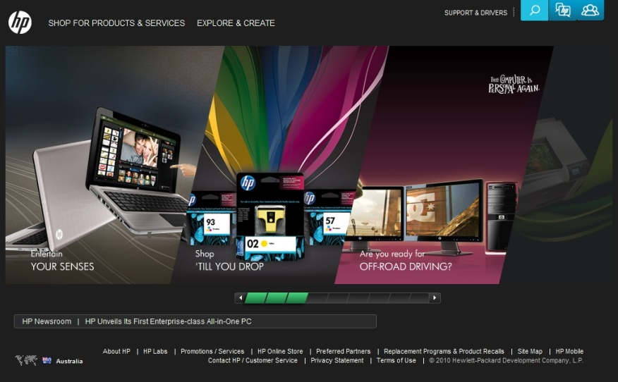

Our Mission
Enable HP to effectively market, sell, and support HP products and services through increasingly demanding digital channels by delivering an HP media ‘supply chain’
Media Types
Publishing Platforms
Animations
(banners/ demos)
Video
Audio
syndication to
Partner sites
PLUS Images and Documents
Web
Mobile
hp.com
Notes:
Rich media is exploding in the industry and Hp is lagging in capability
research data (1/2 searches on mobile devices, -by 2013, 90% of all consumer IP internet traffic will be video, and 64% of total mobile IP traffic will be video, video increase conversion by 30% and boost average ticket by 13% - Every .1% of conversion in the channel is worth $64 million revenue dollars to HP. )
Increasing customer traffic (large emerging marketing impact)
Increasing spend per transaction
Reducing bounce
Reducing the cost to Hp to deliver

Slide 4
Strategic Focus Areas
Drive Operational Efficiencies
Centralized repository for rich media
Assets tagged with pan HP metadata
Improved process workflow
Agency and channel partners access and ease of use
More efficient and effective translation capability
Increased analytics capability
Channel Enablement, Social/Digital Media Enablement
Expand Digital Capabilities
Enable use of the more ‘rich’ forms of digital media (e.g. video)
Expand mobile technology
Increased findability and relevancy for the customer
Proliferate HP content beyond the walls of HP, including more regions, countries and locals
Strengthen the HP brand

Slide 5


MSC Technology Platforms
End to End storage, management, and delivery of rich media
Autonomy – MediaBin
IDOL Search
Liquid Office Process Workflow
Online Video Platform
New OVP

Slide 6
MSC Schedule
FY’11
FY’12
Q3
Q4
Q1
Q2
May | Jun | Jul
Aug | Sep | Oct
Nov | Dec | Jan
Feb | Mar | Apr
R1
Set up and Install
R2
System First ‘ Go Live’
Video and Animation Capability
Deployment to Flix Media, Online Video Platform
Basic Workflow
Scaling Functionality for 80,000 users
Scalability for max use
Customized workflows
Image/documents enabled
Online Video on boarding
Ongoing on-boarding
Demos
Demo
Ramp begins
Deploy as needed
to publishers
Legacy system s shutdown
Videos
Demo
Link to OVP
Feedroom shutdown
Images
Demo
Slow Ramp
Fast Ramp
(public)
Docs/other
Demo
Begin load as possible (Brand first)
Notes:
Demos – Flix Media and SMB; does not include RMA shutdown

Slide 7
OVP Schedule
FY’11
FY’12
Q3
Q4
Q1
Q2
May | Jun | Jul
Aug | Sep | Oct
Nov | Dec | Jan
Feb | Mar | Apr
Contract Signed
Galleries and Players Designed
Galleries and Players Ready
Stand Up Platform
Connect to MSC
Migrate Content
New videos loaded to OVP
Migrate Embeds
Shutdown Feedroom

Slide 8
OVP Platform Baseline Capabilities
Business Capability | Feed room | New OVP | Business Need
Stream to mobile | no | yes | Capability to reach all ‘connected’ devices (mobile, etc) in order to better reach emerging markets, have fully integrated campaigns, and respond to the mobile explosion. Fundamentally, this is the way our customers are shopping.
Social platform syndication | no | yes | Ability to maintain HP branded video experiences on all social platforms (including ad-serving, calls to actions that travel with the video player). Branded players will strengthen brand and also drive traffic to HP sites.
Worldwide business analytics | no | yes | Create more effective videos and distribution strategies. (who watched, for how long, from what platforms, with what satisfaction, from what domains, etc…). Ability to learn how customers are using our content, and respond to customer actions. Limited reporting capabilities of Feedroom are limiting our chance to understand preferences and usage.
SEO (search engine optimization) | no | yes | Enable major search engines to index and find HP videos. Will significantly increase findability of videos, engaging more customers, driving more traffic to HP, and ensuring customers stayed engaged longer and spend more dollars.
DAM integration | no | yes | Enable cost efficiencies, reuse, and findability.
In stream Call to Actions | no | yes | Drive customers to action with clickable links during critical points of video (such as “buy ink now”). Increase conversion rates, increase traffic to HP sites.
Monetization (ad serving) | no | yes | Ability to link videos to HP ad-servers, extending reach for ad dollars. (pre-roll, mid-roll, post-roll). Offer video viewers opportunities, while watching video, to move to purchase HP product.
Ratings from embedded players | no | yes | How satisfied are customers with the HP video? (critical for support team and very powerful for marketing)

Slide 9
OVP Platform Challenges
Storing PDF reference documents
Not able to load PDF documents to OVP
Can support reference urls
Will need to wait till MSC can manage and deliver documents (TBD)
Podcasts
Audio files will be played as videos without images
OVP working on updated audio capabilities
Need to determine timeline from OVP

Slide 10
Video Migration – tentative schedule (earliest possible)
August 29:
All content migrated from Feedroom to new OVP
Stop loading new content on Feedroom – new content ONLY on new OVP
New Gallery and Players available
New and migrated videos stream from new OVP
BU’s begin migrating embeds and links from Feedroom to new OVP
Should do this in priority order
October 31: Shutdown Feedroom
All embedded videos required to migrate are migrated
Review legacy videos, remove or un-publish what’s not needed
Contingency: extend Feedroom through CY11 if needed

Slide 11
Migration Actions
MSC team
Schedule regular (weekly) working meetings with BU on migration (starting week of 7/11)
Manage the migration tasks
Deliver inventory list of Feedroom videos to BU’s
Work with BU’s on migration “strategy”: What to migrate, when, what embed/links need to be migrated
BU’s:
Determine where embedded videos and links are.
Decide which are most critical to change to which ones are not necessary to change at all
Work to change video embeds and links to new OVP
Work with MSC team to review gallery, player, and platform designs

Slide 12
Process Changes
Today (Feedroom): All services (upload, manage, etc) are performed by Feedroom resources (that we pay for).
Tomorrow (August): OVP is a self service platform. BU’s have the option to have a limited number of resources capable of uploading (including metadata), managing (publishing, monetization), etc.
Training provided by MSC Operations Team and OVP
Handholding, through processes provided by Operations Team for some period of time
Work through process with BU, determine tasks
October (or later) Timeframe: OVP will integrate with MSC. Majority of publishing controls likely will be within MSC (details TBD). Additional training and tutoring to be available from MSC Operations Team.

Slide 13
Migration/Processes – Another view
Today
Phase 1 (Aug)
Phase 2 (Oct)
Phase 3 (Nov)
Feedroom
Feedroom
Feedroom
New OVP
streaming
streaming
streaming
streaming
New OVP
New OVP
MSC
Videos uploaded
streaming
streaming
Videos uploaded
MSC
Videos uploaded
Videos uploaded
Process
Videos FTP’d to FR
FR uploads/manages video
Process
Legacy videos stream from FR and OVP.
New videos uploaded and streamed from OVP
Biz or Help desk uploads/manages to OVP
Process
Legacy videos stream from FR and OVP.
New videos uploaded to MSC and streamed from OVP
Biz or Help desk uploads/manages to MSC.
Process
All videos streamed from OVP
Biz or Help desk uploads/manages to MSC.

